Slide 1
Robotics Group Project
Bayesian Localisation and A* Search
Jamie Slome
Jack Galvin
Zehra Punjwani

Slide 2
Hardware Design

Slide 3
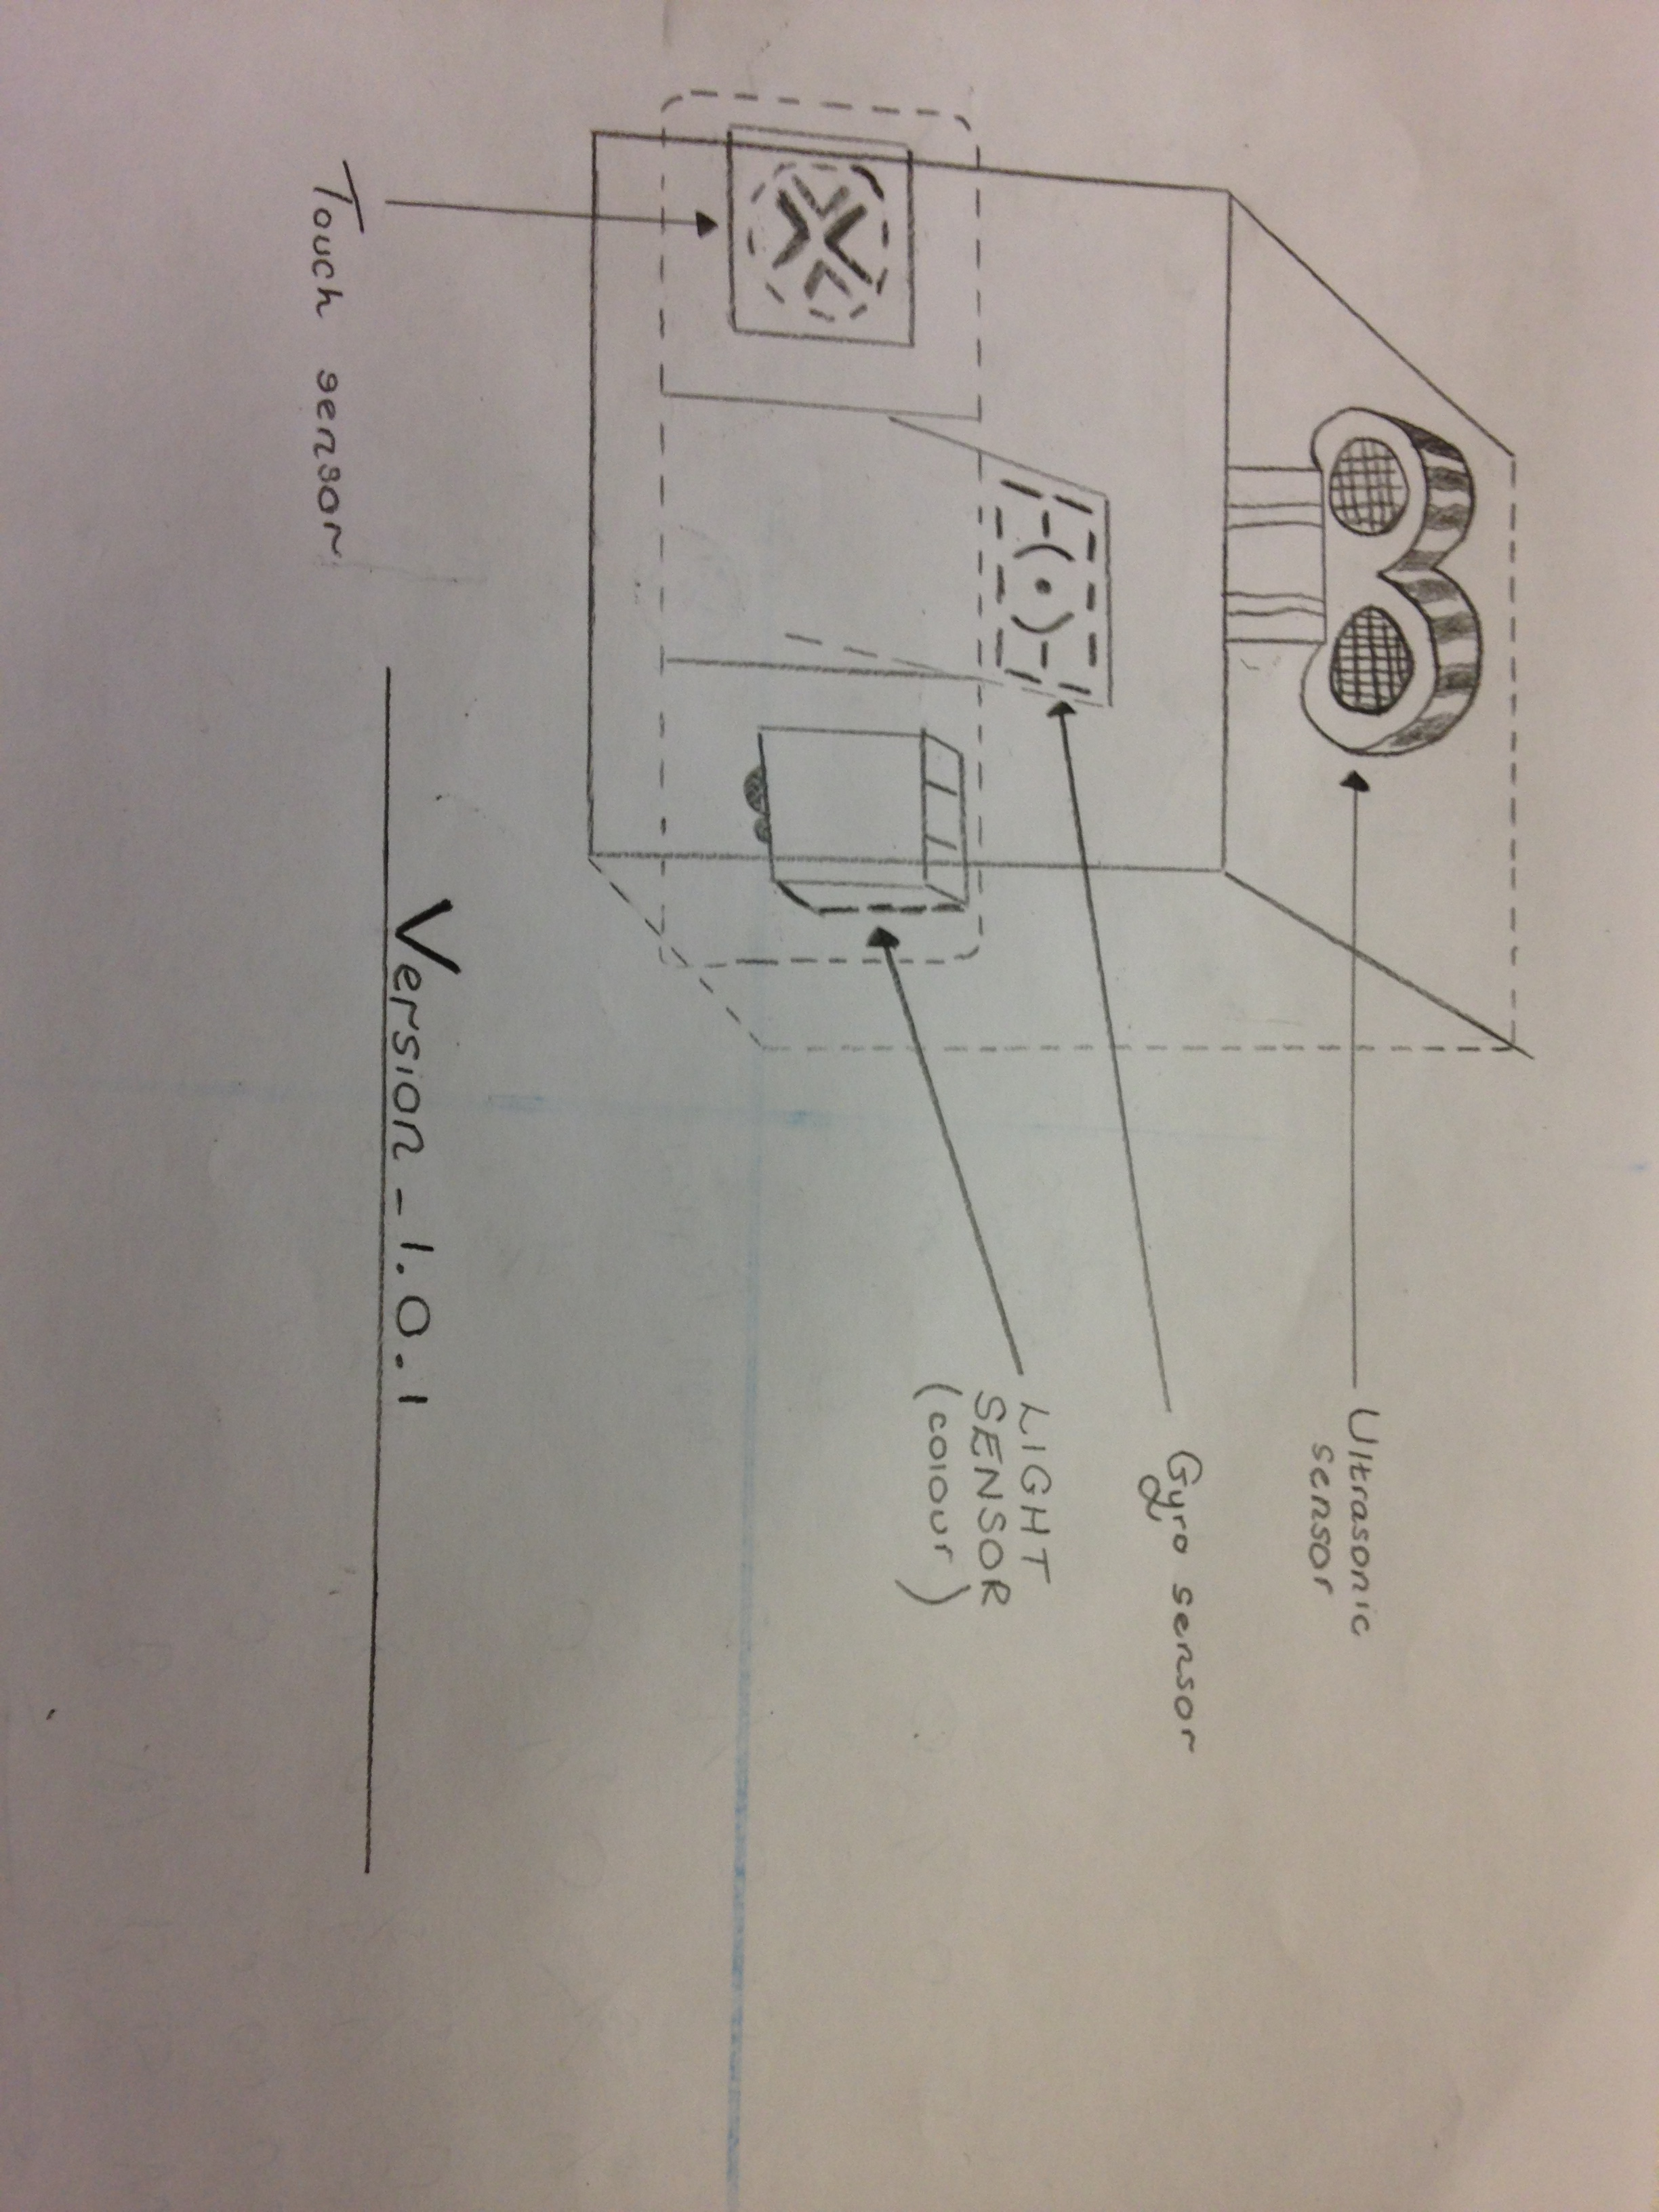
BLU_Print_1.0.0
Ultrasound sensor
Gyroscope sensor
Light sensor
Touch sensor

Slide 4
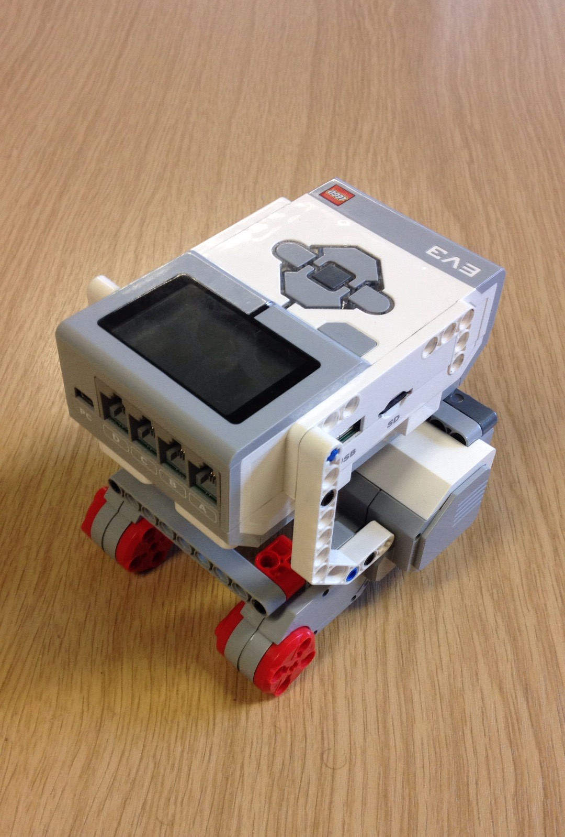
EV3_Vers_1.0.0

Slide 5
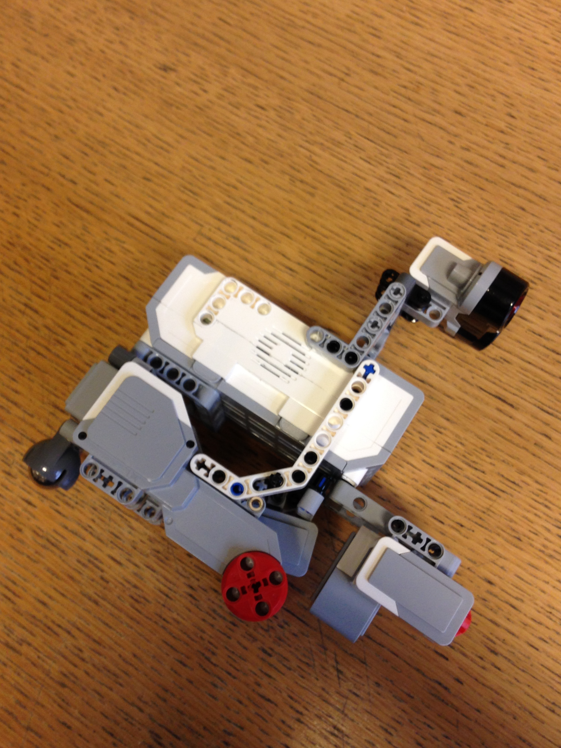
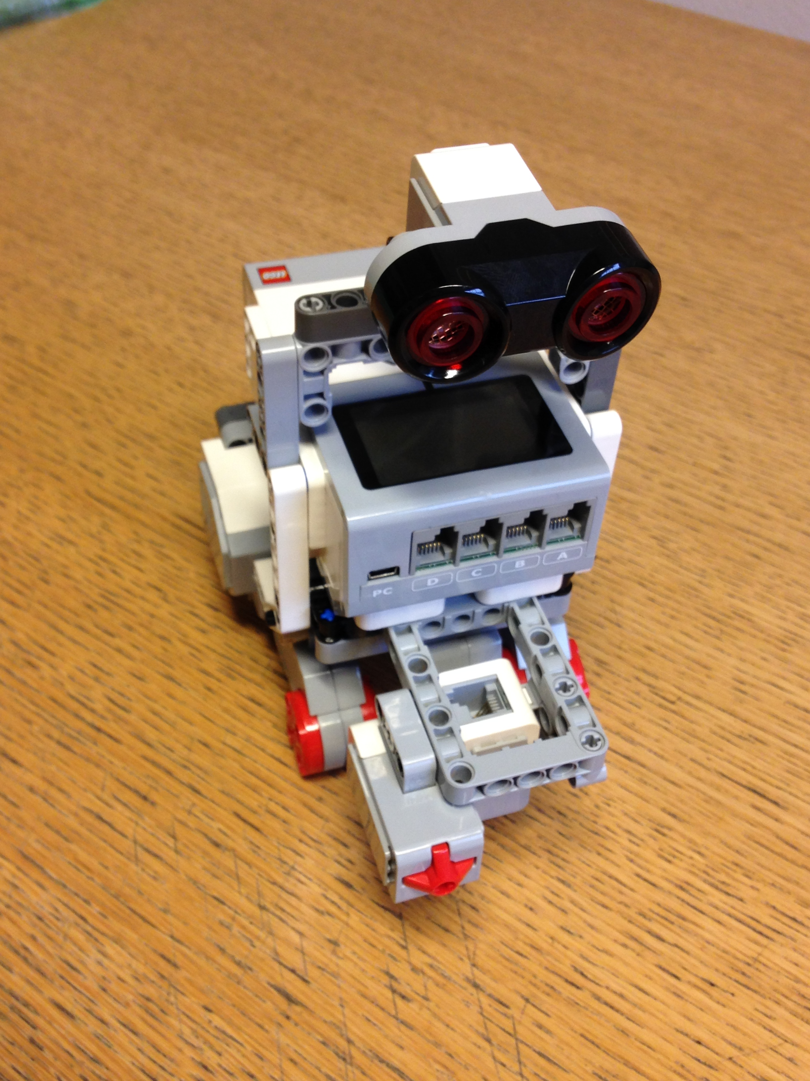
EV3_Vers_1.0.1

Slide 6
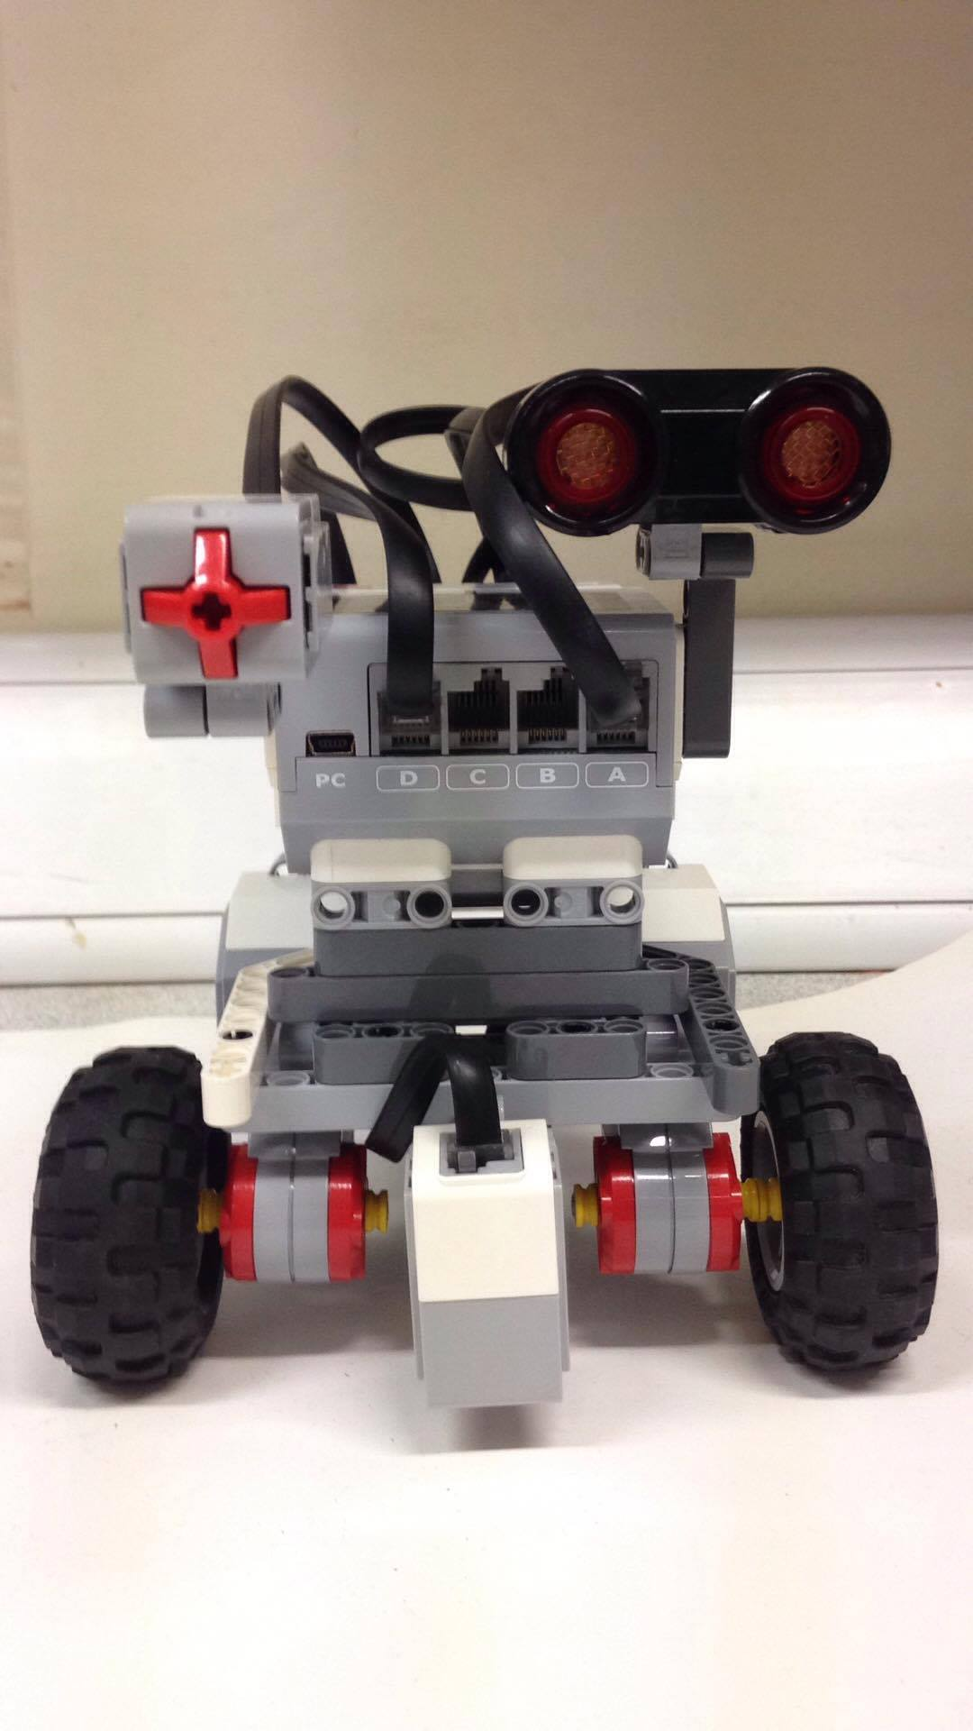
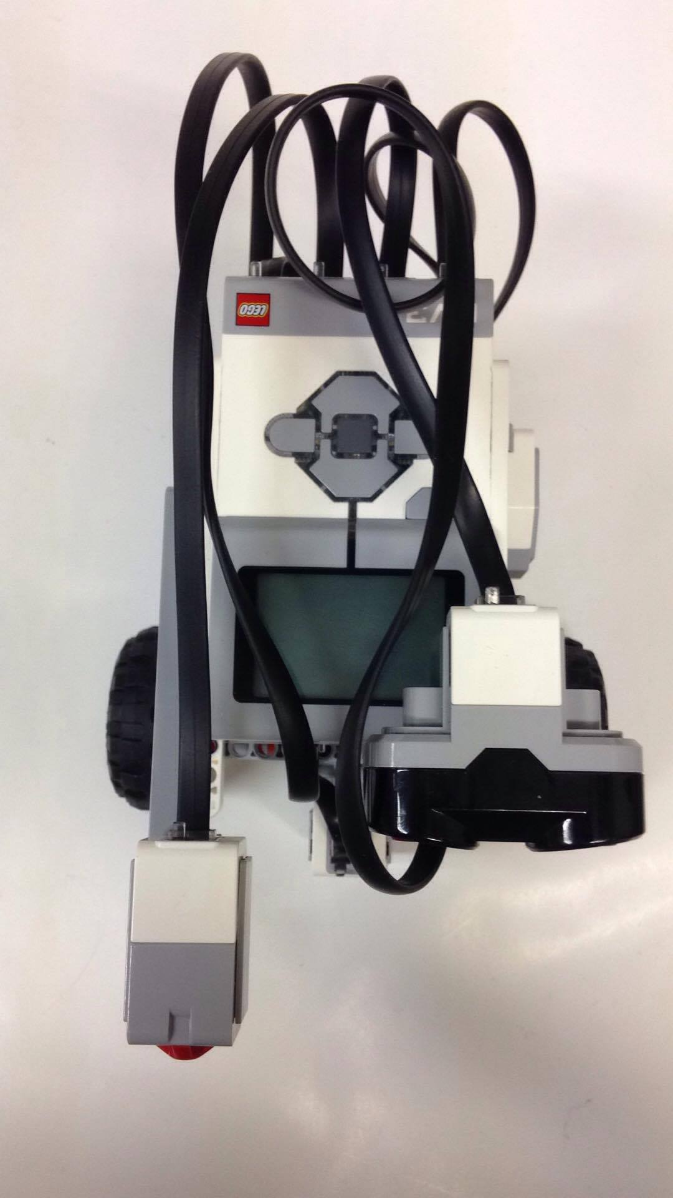
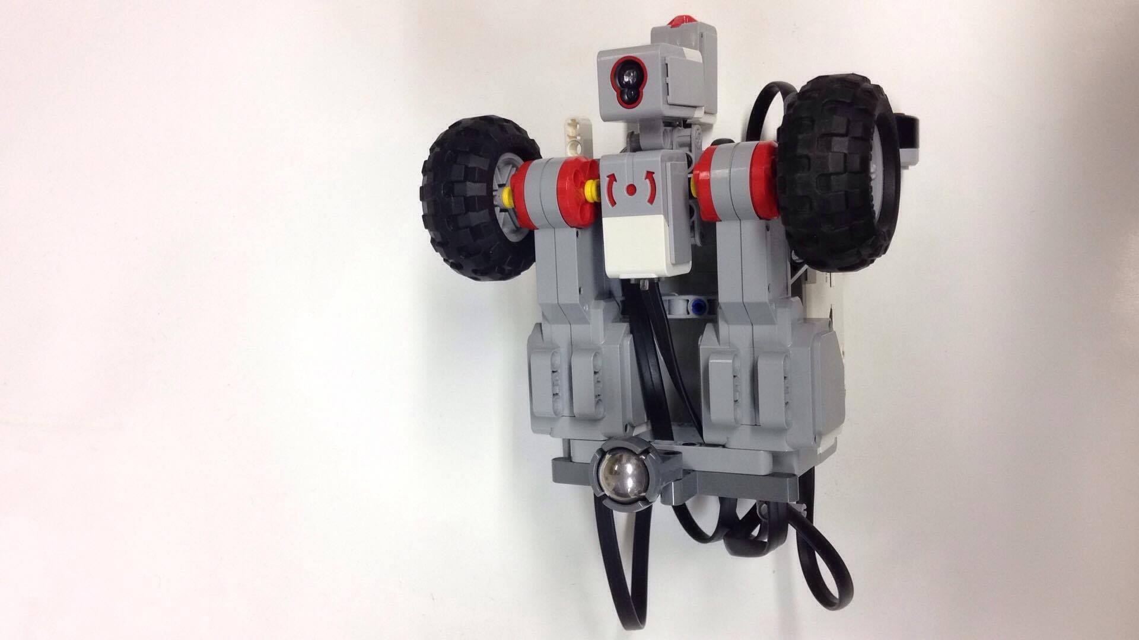
EV3_Vers_1.1.0

Slide 7
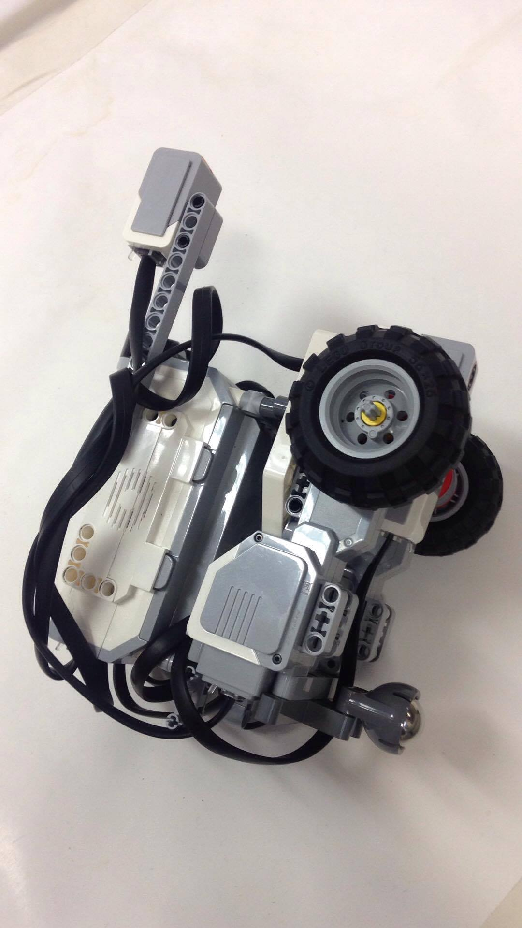
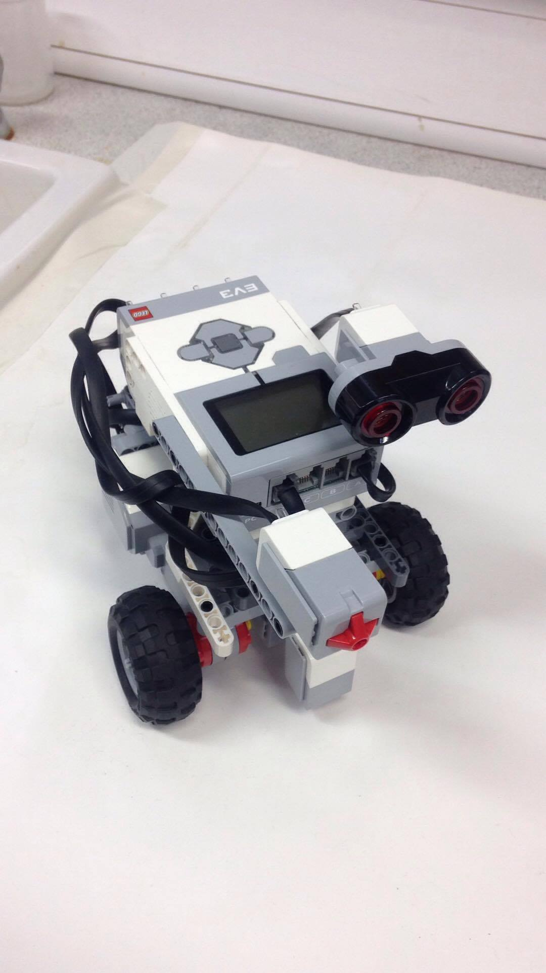
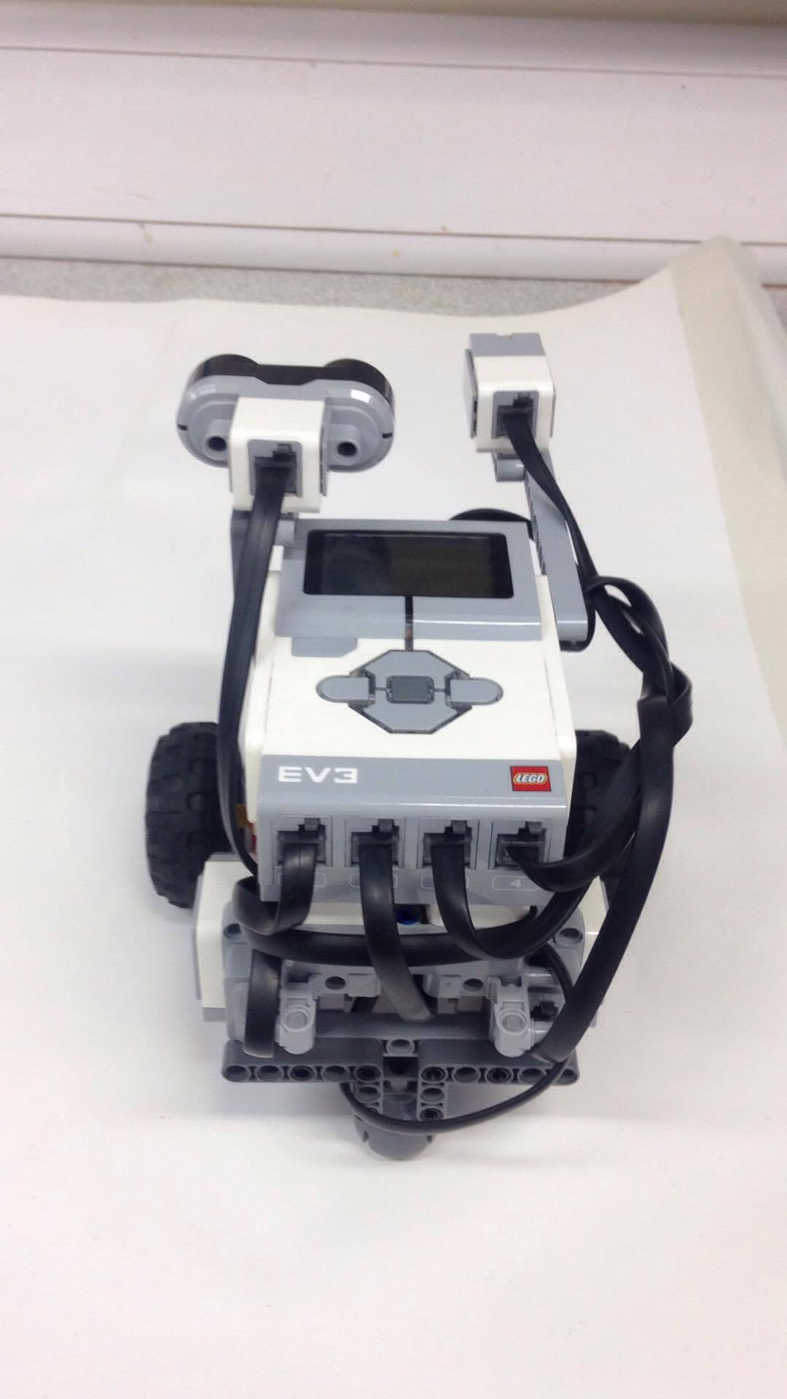
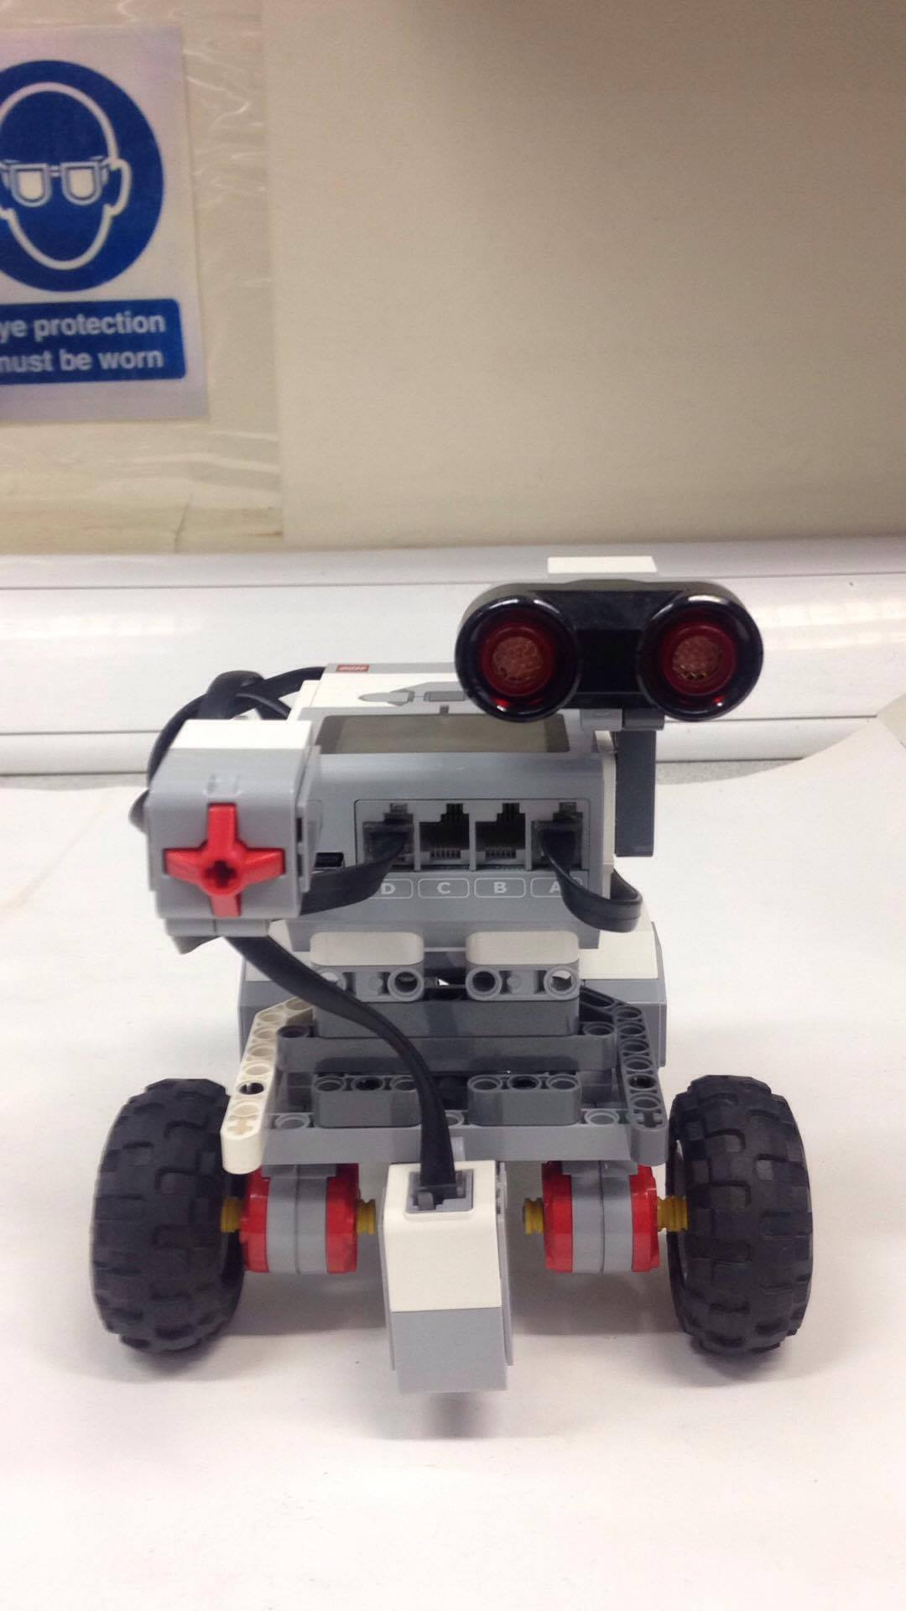
EV3_Vers_1.1.1

Slide 8
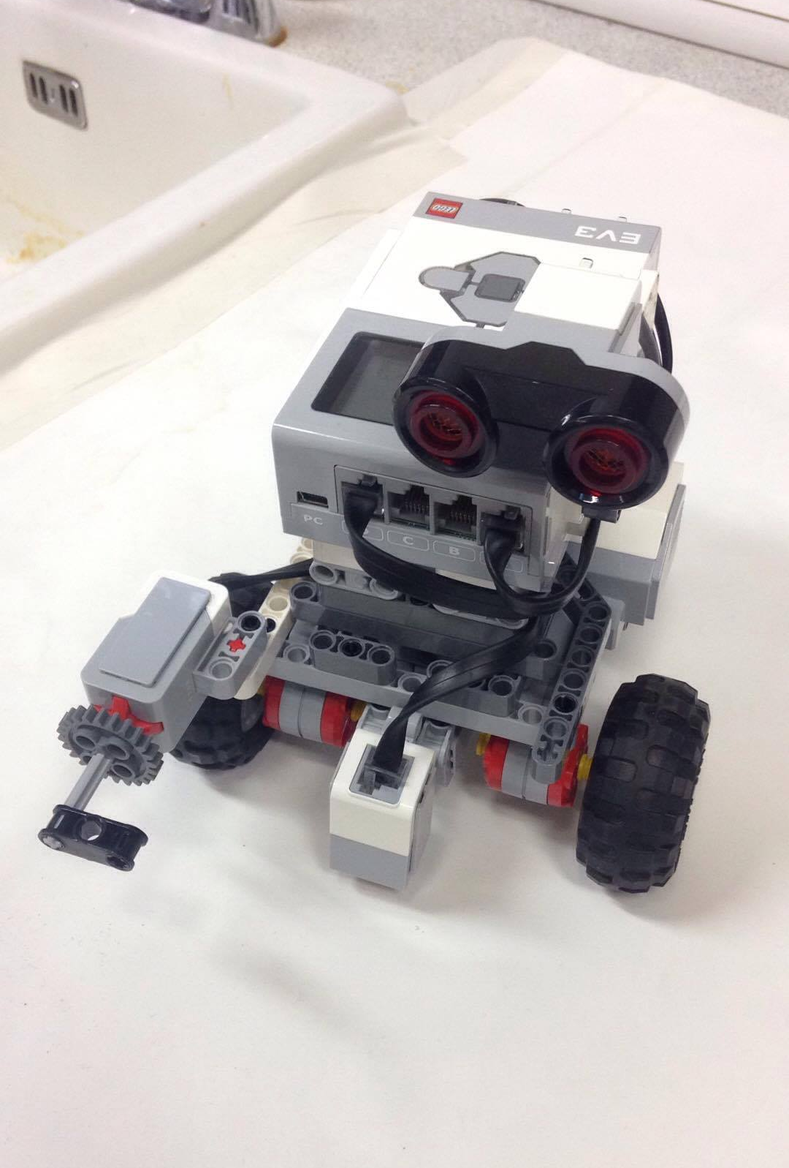
EV3_Vers_1.2.0

Slide 9
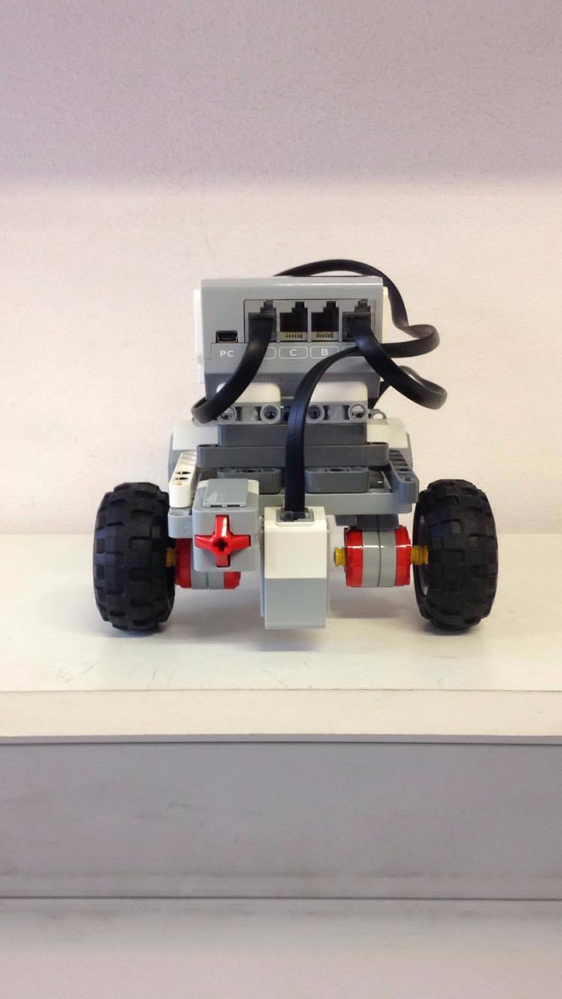
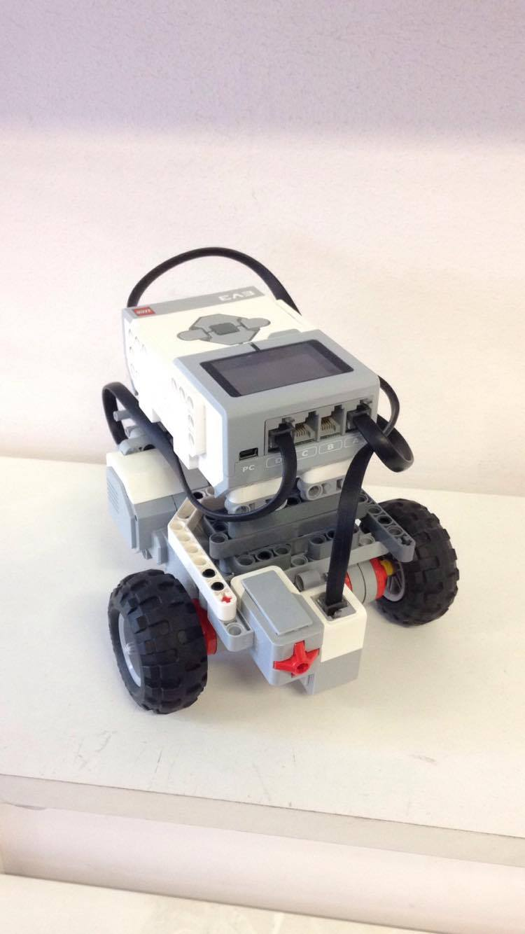
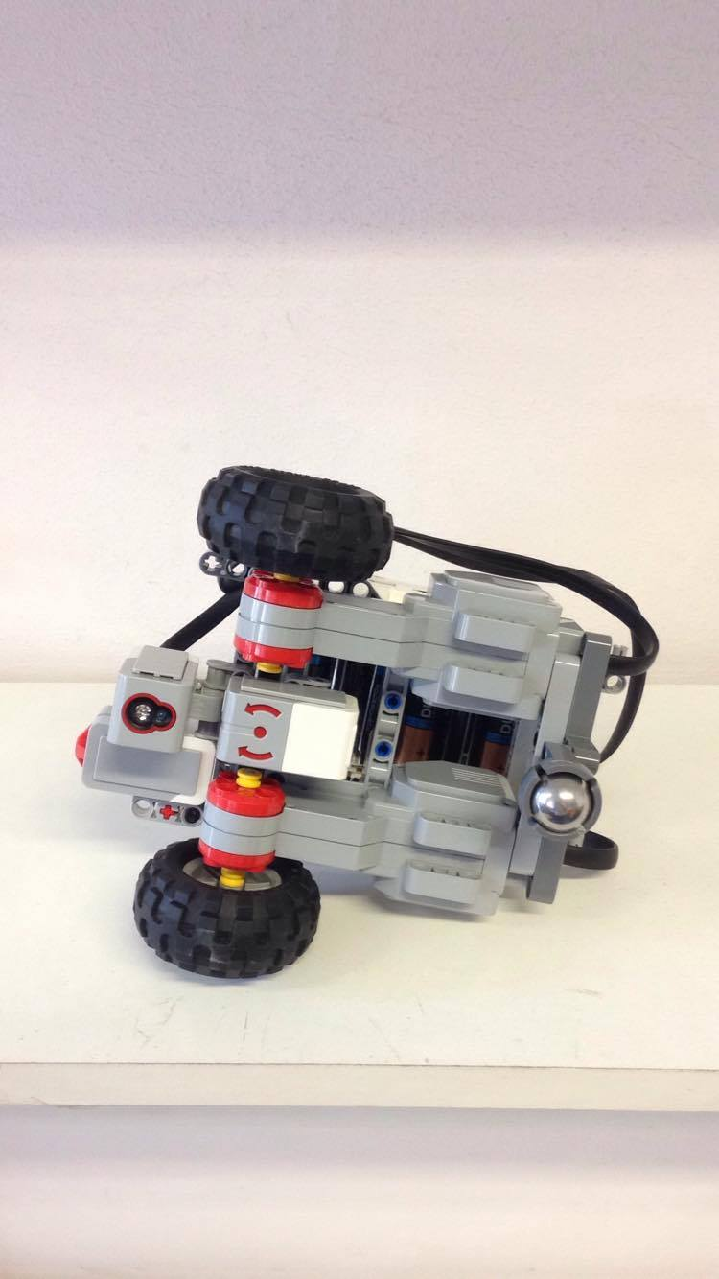
EV3_Vers_1.3.0

Slide 10
Software Design

Slide 11
Bayesian Localisation Pseudo Code
declare lightValue;
declare totalProbability;
declare and initialise arrayOfProb;
for(item in arrayOfProb) {
each item in arrayOfProb -> 1/size of arrayOfProb;
}
while(true) {
lightValue -> reading from sensor;
/*UPDATE*/
for(item in arrayOfProb) {
if(lightValue == arrayOfProb at index item) {
item in arrayOfProb = probSensorWorks * item in arrayProb;
}
else {
item in arrayOfProb = 1-probSensorWorks * item in arrayOfProb;
}
}

Slide 12
Bayesian Localisation Pseudo Code Continued
/*SUM*/
totalProb -> 0;
for(item in arrayOfProb) {
add to totalProbability by each value at index item in arrayOfProb;
}
/*NORMALISE*/
for(item in arrayOfProb) {
item in arrayOfProb = item in arrayOfProb/totalProbability;
}
moveForward(given distance);
/*UPDATE*/
for(index, decrement from back of arrayOfProb) {
if(index == 0) {
index of arrayOfProb= index of arrayOfProb * (1-probMotorWorks);
}
else {
index of arrayOfProb = index of arrayOfProb * (1-probMotorWorks) + index -1 of arrayOfProb* probMotorWorks;
}
}
/*SUM*/
totalProbability -> sum the total probabilities;

Slide 13
Bayesian Localisation Pseudo Code Continued
/*NORMALISE*/
divide every item in arrayOfProbabilities by totalProbability;
maxValue -> 0;
maxInd -> 0;
for(each item in arrayOfProbabilities) {
if(item > maxValue) {
maxValue -> item;
maxInd -> index of item;
}
}
if(maxValue > 0.75) {
stop motors;
return maxInd*2.0;
}
}
}

Slide 14
A* Search Pseudo Code
initialise openList
initialise closedList
add startNode to openList -> f.Set(0)
while(openList !empty) {
node.lowestF-> q
q.remove -> openList
generateNeighbours of q, setParents -> q
for(each neighbour) {
if(neighbour == goal) {
return finished;
}
set g,h,f of neighbour
if(neighbour in openList with lower f) {
skip node;
}
if(neighbour in closedList with lower f) {
skip node;
}
else {
add neighbour -> openList;
}
}
q -> closedList;
}

Slide 15
Evaluation of Hardware and Software

Slide 16
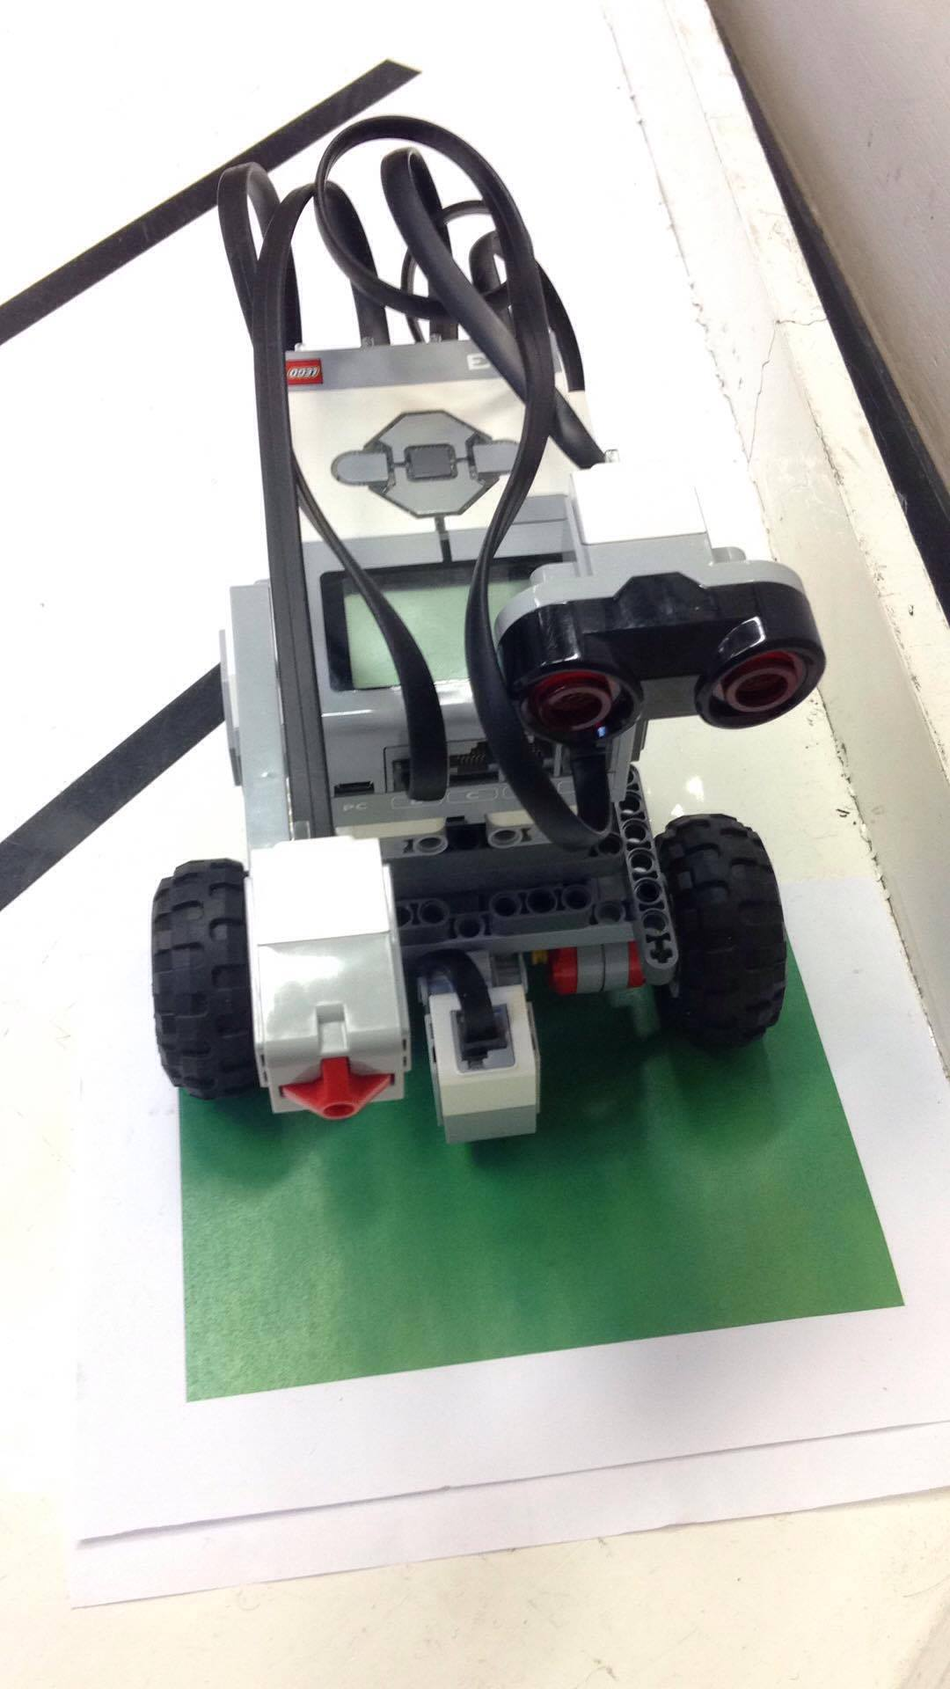
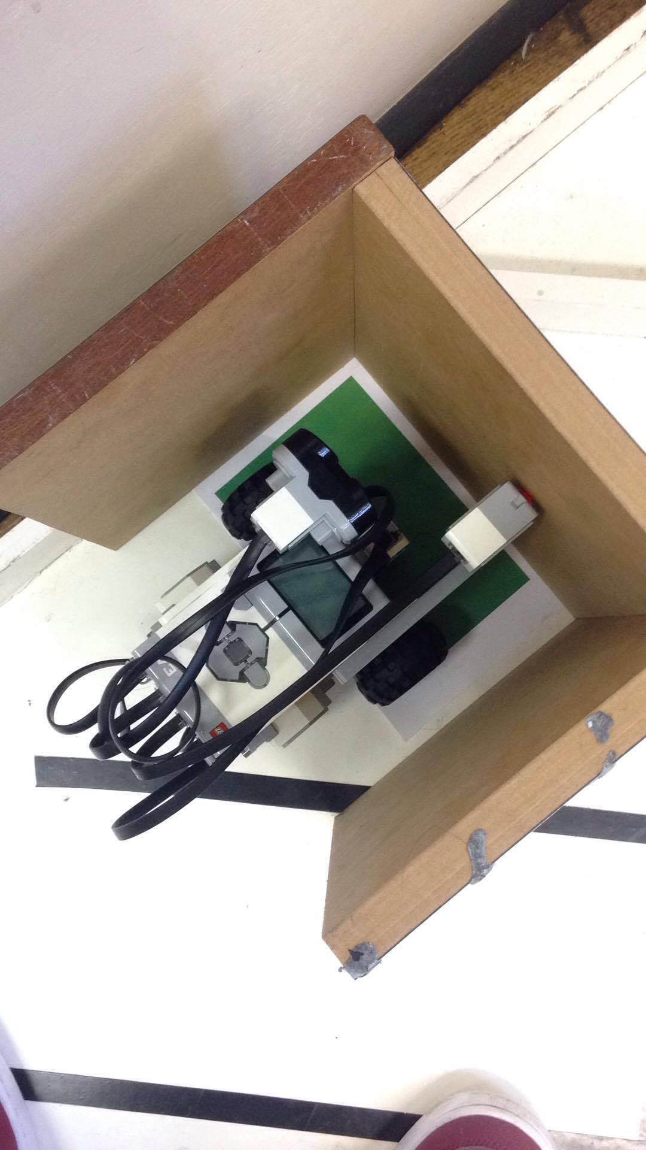
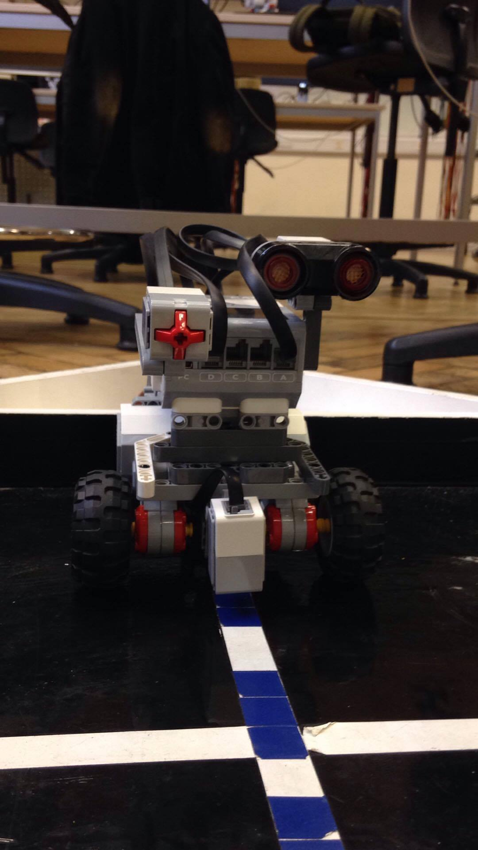
Environmental Application of Hardware

Slide 18
Team Management

Slide 19
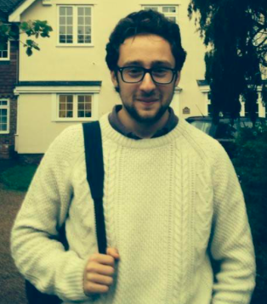
Jamie Slome
Hardware:
Software:
Testing:

Slide 20
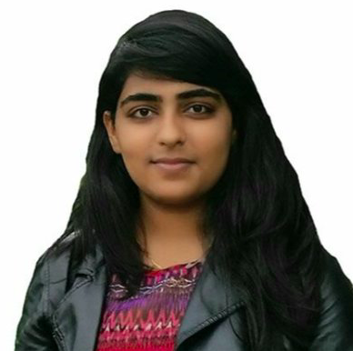
Zehra Punjwani
Hardware:
Software:
Testing:

Slide 21
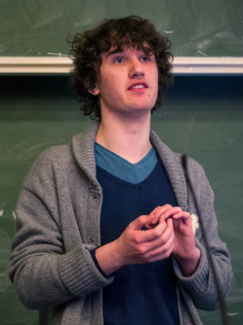
Jack Galvin
Hardware:
Software:
Testing:

Slide 22
Conclusion and Comments

Slide 23
Task 1:
Task 2:
Task 3:
Task 4:
Localise robot with respect to a known line.
Apply Bayesian localisation to accurately determine the robot location.
Plan path from robot location to the goal.
Find the shortest path to goal.
Reach the goal location.
Rotate towards the narrow path.
Move towards the end and read colour.
Signal arrival by using touch sensor then play beep.
Manoeuvre out of the obstacle.
Based on colour of pad, position of obstacle is known.
Plan a route back to starting point using this knowledge.

Slide 24
We could have looked into other path planning methods such as potential field.
We could have assigned members smaller tasks and thus improved the rigidity of the implementation.
We could have improved the efficiency of the code by refactoring and removing duplications.
We could have looked into the use of alternative hardware i.e. Arduino, servo-motors, reliable sensors.
We could have tested the software and hardware more intensely to prevent errors and issues occurring during the implementation stage.

